Slide 1
The truth is in the logs
Vidhya Vijayakumar | Support Operations Manager
vidhya@electric-cloud.com

Slide 2
What do you see and what does it mean
Monitor your ElectricFlow server performance
Database related issues and what to look for
Log Collection

Slide 3
Which files do we care about?
ElectricFlow Server(s)
Web/Apache server
<data-dir>/logs
commander-hostname.log
commander-service
*.hprof
<data-dir>/apache/logs
access.log
error.log
<data-dir>/logs/agent
jagent.log
ElectricFlow Agent
Repository server
<data-dir>/logs/agent
jagent.log
Agent.log
service.log
<data-dir>/logs/repository
repository.log
service.log
<data-dir>/logs/agent
jagent.log

Slide 4
Possible Issues
UI not responding
Server crashing often
Host Memory Usage spikes
Host CPU Usage very high
Slow Jobs/Builds

Slide 5
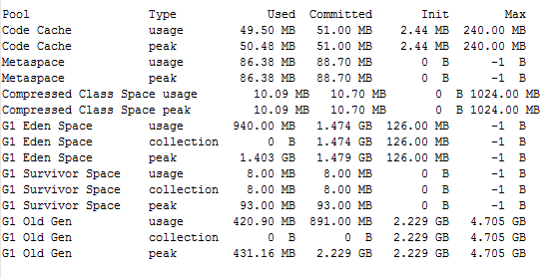
Server Health - Memory
Memory Metrics- every 15 minutes

Slide 6

Server Health – CPU usage/File Handles
CPU Usage – every 1 minute
Open File Handles– every 1 minute

Slide 7
Database Related Issues – SQL trace
Database Connection
ServerNotReady: Couldn't dispatch request…
WARN Can't connect to the database:…
org.hibernate.exception.GenericJDBCException:
Could not execute JDBC batch update
Object Deletion
ConstraintViolationException
DataIntegrityViolationException
NullPointerException
Operation exception:
java.lang.NullPointerException: null

Slide 8
How do I collect logs?
Plugins available to collect and upload logs
EC-Support - Procedures to interact with Electric Cloud support
EC-ShareFile – Sharefile upload integration
EC-Zendesk - A plugin to communicate with Zendesk

